Slide 1
Online News popularity
Group 13
Sravya Chouta,
Roshan Dhanasiri,
Sierra Laoratanapong,
Sathwik Maddi

Slide 2
TABLE OF CONTENTS
01
02
03
04
Introduction
Dataset
Technique and model used
result/Discussion

Slide 3
01.
Introduction

Slide 4

Motivation
Social media is one of the most important communication channels for every type of information including news
The data in social media is important to help predict the favor of the audience to posts
We are interested in analytics of social media data to investigate and forecast the popularity represented by shares.

Slide 5
Objective
Predict the popularity of online news using various classification machine learning techniques.
Find the best model (highest accuracy) to predict this dataset.

Slide 6
02.
Dataset

Slide 7
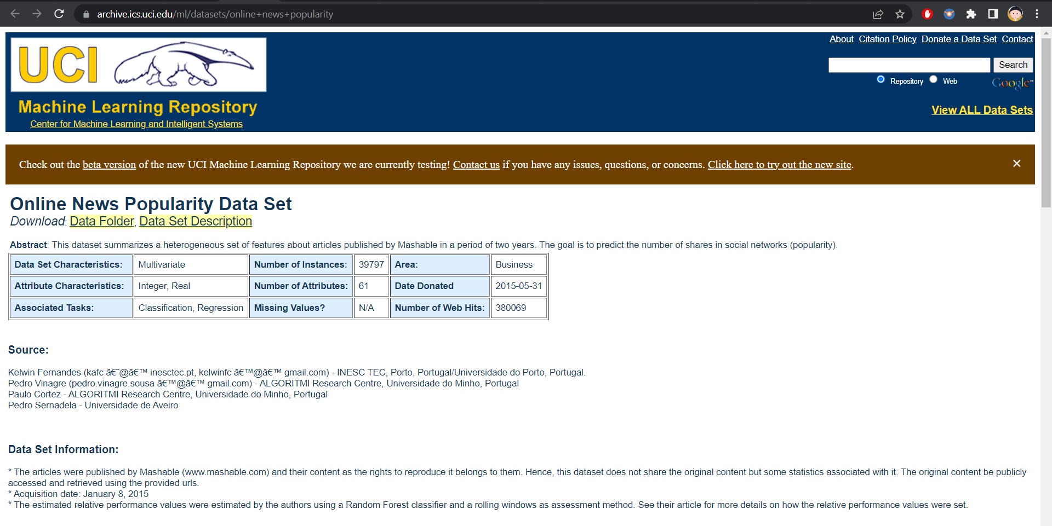
Dataset

Slide 8
Dataset
The dataset named ‘Online News Popularity Data Set’ downloaded from UCI repository
Dataset summarizes a set of features about articles published on the site ‘Mashable’ over two years.
39644 samples and 61 attributes
Target: ‘shares’ >> changed to categorical value by dividing samples by median 1400
Cleaning: drop unused attributes, ‘URL’ and ‘timedelta’
After cleaning: 39644 samples and 59 attributes left
The dataset was randomly split 70:30 into training dataset and testing dataset.

Slide 9
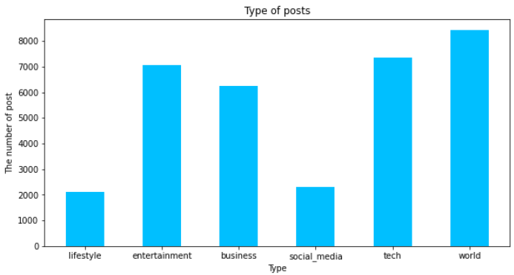
Dataset
Most frequent type of posts is world

Slide 10
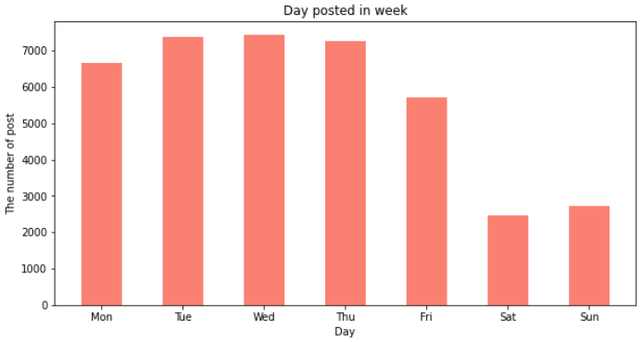
Dataset
The articles were posted on weekday more than weekend

Slide 11
03.
Technique
And model

Slide 12
Technique
Data exploration: see dataset, find related and unrelated variables
Data cleansing: drop NA, unrelated variables
Visualization of the data:
Data structuring: choose classification machine learning techniques
Feature engineering and selection: create new target variable ‘Y’ from ‘shares’, divide into 2 groups by median = 1400
Shares equal or less than 1400 >> 0
Shares more than 1400 >> 1

Slide 13
Technique
Splitting 70:30 into training dataset and testing dataset.
Running machine learning models
Logistic regression
XGBOOST
SVM
KNN
Naïve Bayes
Decision Trees
Comparing the models, selecting the best model by accuracy.

Slide 14
04.
Result/ discussion

Slide 15
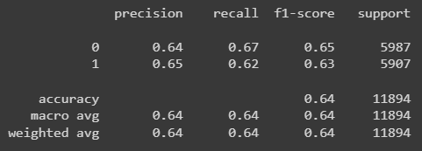
Baseline Model: Logistic regression

Slide 16
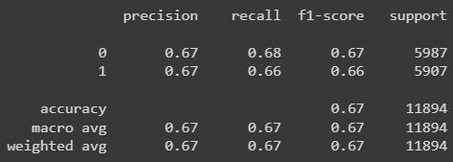
Main model: Xgboost

Slide 17
Result
 | Logistic regression | XGBOOST | SVM | KNN | Naïve Bayes | Decision tree
Accuracy | 0.64 | 0.67 | 0.61 | 0.56 | 0.53 | 0.60
Precision | 0.65 | 0.67 | 0.63 | 0.56 | 0.66 | 0.60
Recall | 0.62 | 0.66 | 0.51 | 0.54 | 0.26 | 0.70
F1-score | 0.63 | 0.66 | 0.51 | 0.55 | 0.21 | 0.65

Slide 18
Discussion
Low accuracy
Overall, the accuracy of all models is not high. The best model has accuracy only 0.67
Best model
In the future
The best model is XGBOOST with 0.67 accuracy, 0.67 precision, 0.66 recall, and 0.66 F1-score
Do more tuning to find better condition.
Try other classification models
Try regression models

Slide 19
Thank you!

